Slide 1
Visual Experience

Slide 2
Paper #1
What Makes a Visualization Memorable?

Slide 3
Introduction
The debate on ‘chart junk’ exists since the longest time in the Visualization community.
Chart junk - whether chart junk should be included or not in visualizations
Other factors - graph type, color and aesthetics
What makes a visualization memorable?

Slide 4
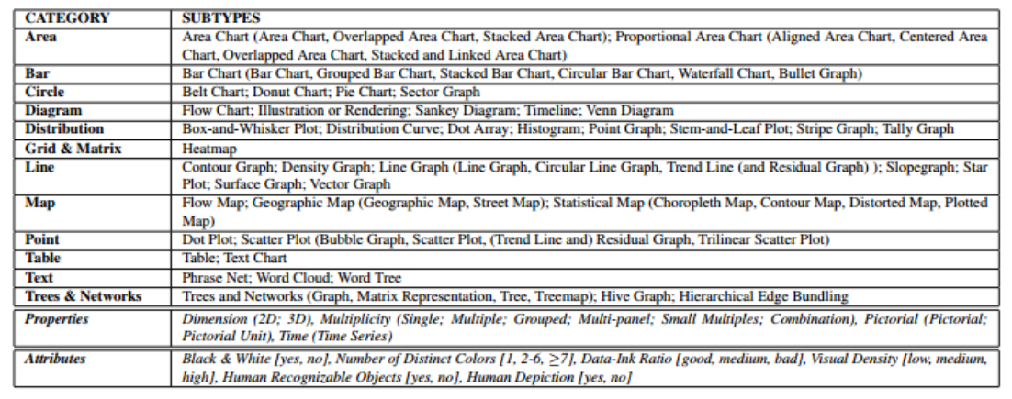
Visualization Taxonomy

Slide 5
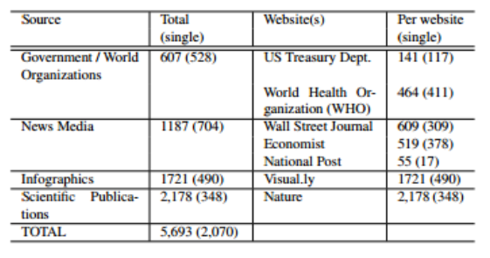
Visualization Sources

Slide 6
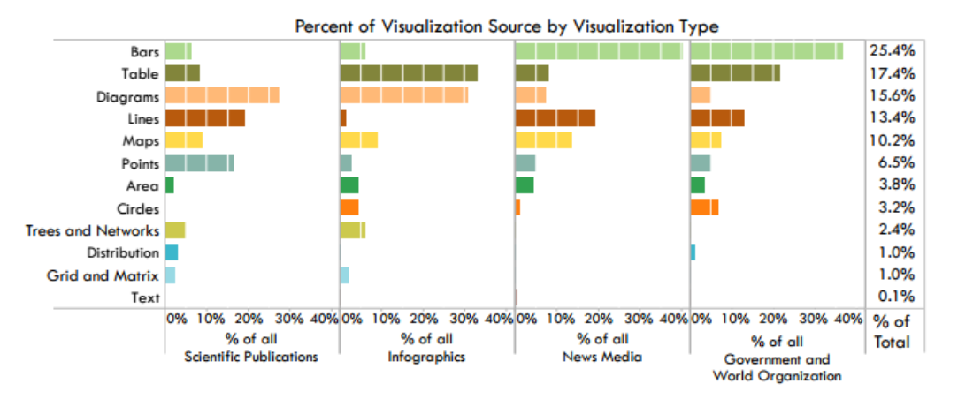
Breakdown of visualization categories for various sources

Slide 7
Observations
Tree and network diagrams only appear in scientific and infographic publications
Greater use of circle plots (e.g., pie charts) in government reports
Absence of text visualizations from almost all publication venues

Slide 8
Memorability Experiment
Hypotheses:
•H1 Participants will perform worse (i.e., overall have a harder time remembering visualizations) as compared to natural images/ photos.
•H2 A visualization is more memorable if it includes a pictogram or cartoon of a recognizable image.
•H3 A visualization is more memorable if there is more color.
•H4 A visualization is more memorable if it has low visual density.
•H5 A visualization is more memorable if it is more “minimalist” (i.e., “good” data-ink ratio).
•H6 A visualization is more memorable if it includes a “familiar” visualization type (i.e., basic graph type taught in school).
•H7 A visualization is less memorable if it comes from a scientific publication venue.

Slide 9
Experimental setup
•Participants were presented with a sequence of images, and had to press a key if they saw an image twice.
•The repeated images were the target images.
•17 levels, each having 120 images.
•Vigilance repeat images to screen out participants not paying attention.
•Repeat images appeared 91-109 images apart.

Slide 10
Experimental Design and Analysis
•Each target image was seen at most twice.
•Hit rate (HR) = HITS/ (HITS + MISSES)
•False alarm rate (FAR) = FA / (FA + Correct rejections)
•d’ metric used as a memorability score.
d’ = Z(HR) – Z(FAR)
•Memorability score was plotted against visualization attributes.

Slide 11
Memorability comparisons
Comparison
•Scene memorability : Mean HR of 67.5% (SD = 13.6%) and Mean FAR of 10.7% (SD = 7.6%)
•Face memorability : Mean HR of 53.5% (SD = 14.3%) and Mean FAR of 14.5% (SD = 9.9%)
Consistency
•Participants split into two independent groups and memorability scores compared.

Slide 12
Visualization attributes
•145 visualizations contained pictograms, and these had a higher score. This supports H2.
•Visualizations having more color, high visual density and low data-ink ratio have a higher score. This supports H3 and refutes H4 and H5.
•‘Unique’ visualizations are more memorable.
•A common aspect of memorable visualizations : circles and round edges.

Slide 13
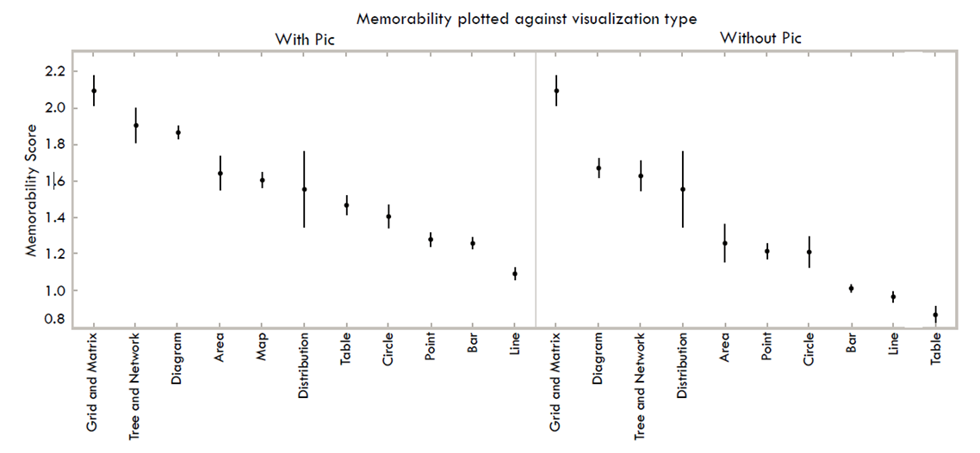

Slide 14
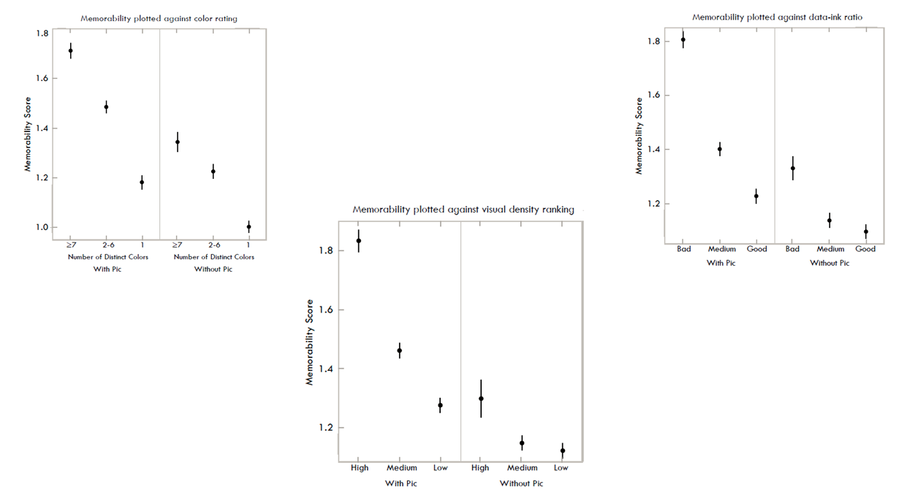

Slide 15
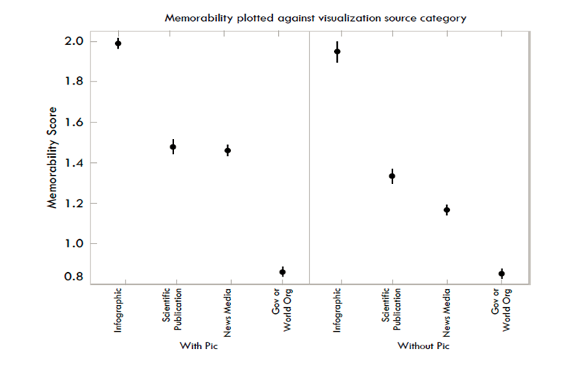
Visualization sources
•Highest: Infographic
•Second: Scientific publications
•Lowest: Government and world organizations

Slide 16
Conclusion
•Visualizations are intrinsically memorable.
•Less memorable than natural scenes, but similar to facial images.
•Natural looking visualizations( diagrams, heat maps) are more memorable.
•Unique visualizations have a higher memorability than common ones like graphs and pie charts.
•Memorable visualizations: Not just a part, relevant aspects of the data or what the author is trying to convey.

Slide 17
Visualization Rhetoric
Framing Effects in Narrative Visualization
Jessica Hullman and Nicholas Diakopoulos
Notes:
Reactions online seemed to indicate that people were having difficulty with jargon
Hopefully cut through all that and help you all understand what this paper was talking about
Use visualizations to tell a story and influence interpretations
Slides from 2nd author… https://github.com/comp-journalism/UMD-J479D-J779D-Fall2015/blob/master/Slides/9_Visualization%20Rhetoric%20and%20Critique.pptx

Slide 18
Terminology
Rhetoric
Motivation on part of communicator to gain adherents to a preconceived view or conclusion.
Bias
Systematic encouragement of one outcome over others
Frame
To form or articulate, shape or construct
Notes:
The terms we use have different connotations. Frame is neutral. Bias usually isn’t.

Slide 19
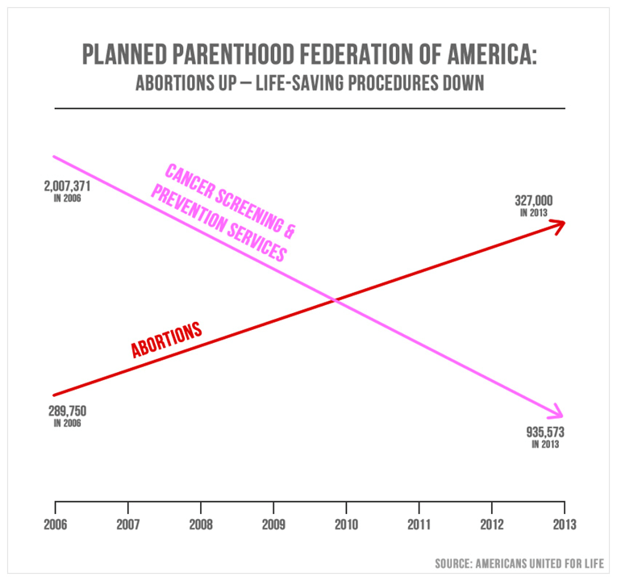
Notes:
The way we present data and arguments visually has an affect as well! Here we have a visualization that’s trying to tell a particular story… What’s “wrong” with this visualization?

Slide 20
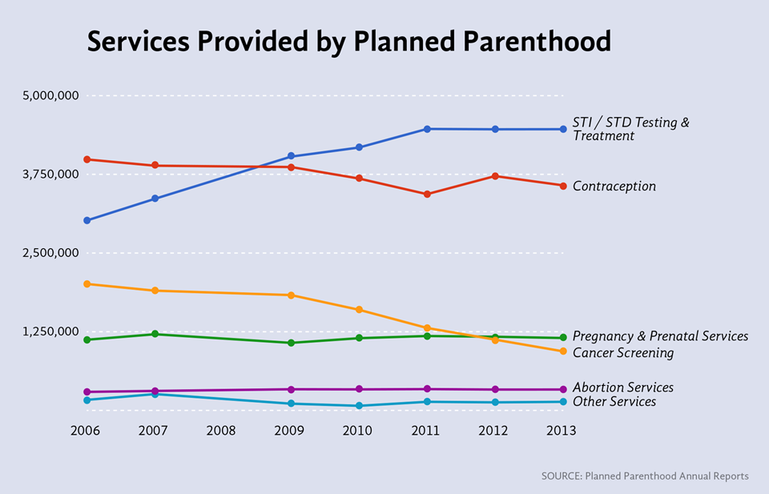

Slide 21
Video
Should the Y axis start at zero?

Slide 22
Editorial Layers
Data - What to include and leave out?
Visual Representation - How to map the data to the visual domain?
Annotations - What textual, graphical, social commentary to include?
Interactivity - How should the user navigate the data?
Notes:
When choosing to present information, you can manipulate the visualization on several layers.

Slide 23
Editorial Layers: Data

Slide 24
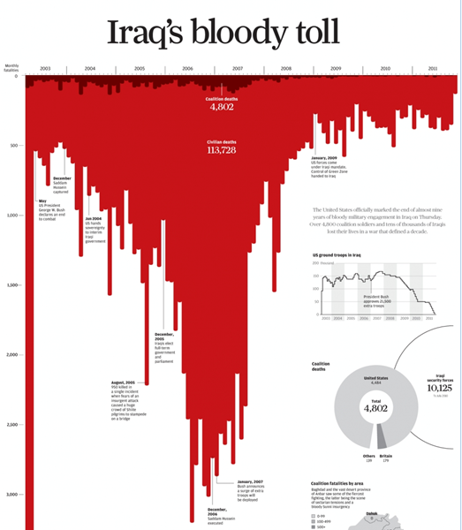
Editorial Layers: Visual Representation

Slide 25

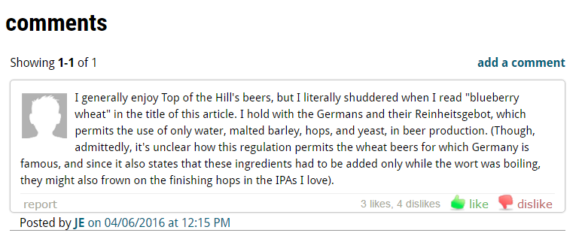
Editorial Layers: Annotations

Slide 26
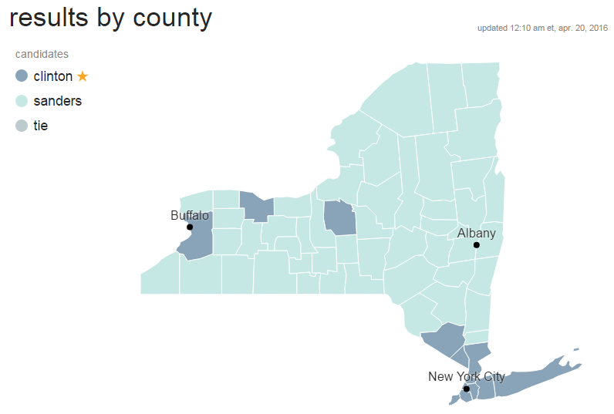
Editorial Layers: Interactivity
CNN Election Center:

Slide 27
Visualization Rhetorical Framework
• Analytical framework guide to analyze the different layers of a visual presentation - data, annotations, interactivity etc used to convey an intended story to the user.
• Methodology
A sample of 51 diverse, professionally produced narrative visualizations were analysed.
Familiarize with framing or bias techniques and media and communication studies.
Iteratively coded particular techniques we observed based on this.
Observed that the techniques basically represent different implementations of the same basic function, leading to “families” of similar techniques.
Next, Affinity Diagrams( business tool used to organize ideas and data) were used.

Slide 28
Rhetorical Techniques
Four Higher level clusters of techniques based on Affinity diagramming.
Information access rhetoric functioning: - limiting the amount of information presented
Provenance rhetoric functioning:- providing background information
Mapping rhetoric functioning :- mapping elements of the visualization to non-explicit concepts
Procedural rhetoric functioning :- constraining interaction over time
Notes:
Note : Another cluster that doesn’t share a common mechanism, clustered based on linguistic origins.

Slide 29
Information Access Rhetoric
What Data to represent !
Not including complex ideas, less distractions, excluding something that can be implicitly inferred from the data/ context, omitting origins.
Assumes prior knowledge.
Omission techniques :
Axis thresh-holding.
Metonymy techniques
Averaging techniques: mean, median
Categorizing, Binning, Aggregating values

Slide 30
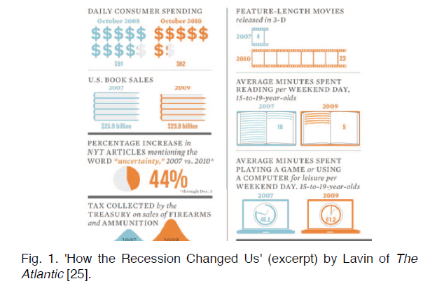
Omission Techniques cont..

Slide 31
2. Provenance Rhetoric
Objective:
Impartiality
Transparency, truthful,
Clarity
Data Provenance: Citing the resources/ sources/ references/ relevant facts explicitly.

Slide 32
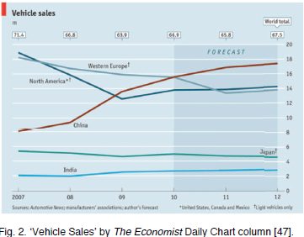

Slide 33
3. Mapping Rhetoric
Manipulating the information presentation via the data-to-visual transfer function.
Obscuring : due to noise in the representation, applying unnecessary sizing transformations.
This can lead to making some elements too small for judgment or oversizing to the point of overwhelming the presentation.
Neglect mapping information to the most salient visual judgment types

Slide 34
4. Procedural Rhetoric
Persuasion through rule-based representations and interactions, rather than the spoken word, writing, images, or moving pictures
the art of using processes persuasively to express the meaning.
Ex: use procedural rhetoric in the form of game mechanics to drive attention in an interactive information graphic.

Slide 35
Viewing Codes
Refer to how the how attributes of the receiver of an artifact influence interpretation.
The cultural,perceptual, cognitive, and psychological factors that guide how an end-user (or community) interprets a representation.
The constraints imposed on end-user interpretations by habits and beliefs that are not explicitly contained in the visualization but rather implied by visualization element
What the user expects to interpret from a visualization format based on prior experience. Ex: Bar graphs for discrete trends, line graph for temporal trends

Slide 36
Examples of Codes.
Cultural codes: social norms and wider beliefs of a culture that a designer can target to suggest a particular interpretation.
Individual-level codes: can be higher-cognitive constraints (e.g., abilities) or more emotionally-based patterns of reaction.
Perceptual codes : constrain what is salient to the user given the human visual perception tendencies
Textual codes: the conventions associated with the presentation and interpretation of text. Ex: positioning of the title bar on the web page
Aesthetic Codes: combine perceptual as well as shared yet subjective references for a particular style of presentation. Ex: colorless backgrounds & avoiding unnecessary ornamentation create a particular aesthetic code.

Slide 37
Denotation vs Connotation
Denotation:- refers to descriptive elements, including either textual or visual statements (such as iconography) that directly attribute features to objects
Connotation:- secondary, indirect symbol cues, but does not directly associate, a meaning.

Slide 38
Summary
Immense opportunity for increasing understanding of the complementary relationship between explorative and communicative dimensions.
Developing a deeper understanding of rhetorical devices and styles for communicating meaning, particularly those that add information such as annotations of methodology and uncertainty representations, could allow analysts to better communicate their findings improving communication of insights in collaborative visual analytics.

